Slide 1
HR Analytics Project
In this project we aims to model the probability of attrition of each employee from the HR Analytics Dataset, available on Kaggle. Its conclusions will allow the management to understand which factors urge the employees to leave the company and which changes should be made to avoid their departure.

Slide 2
What we use in this Project?
We are using following software and tools:
Python language for data visualization
Jupiter Notebook
Modules required in Python
1) matplotlib module
2)Pandas module
Use Official documentation for reference
HrAnalytics_test.csv file that consist all data.
HrAnalytics_train.csv file that consist all data.

Slide 3
Something About HR Analytics
What is HR Analytics?
HR analytics is the process of collecting and analyzing Human Resource (HR) data in order to improve an organization’s workforce performance. The process can also be referred to as talent analytics, people analytics, or even workforce analytics.
For example, if a software engineering firm has high employee turnover, the company is not operating at a fully productive level.
It takes time and investment to bring employees up to a fully productive level.

Slide 4
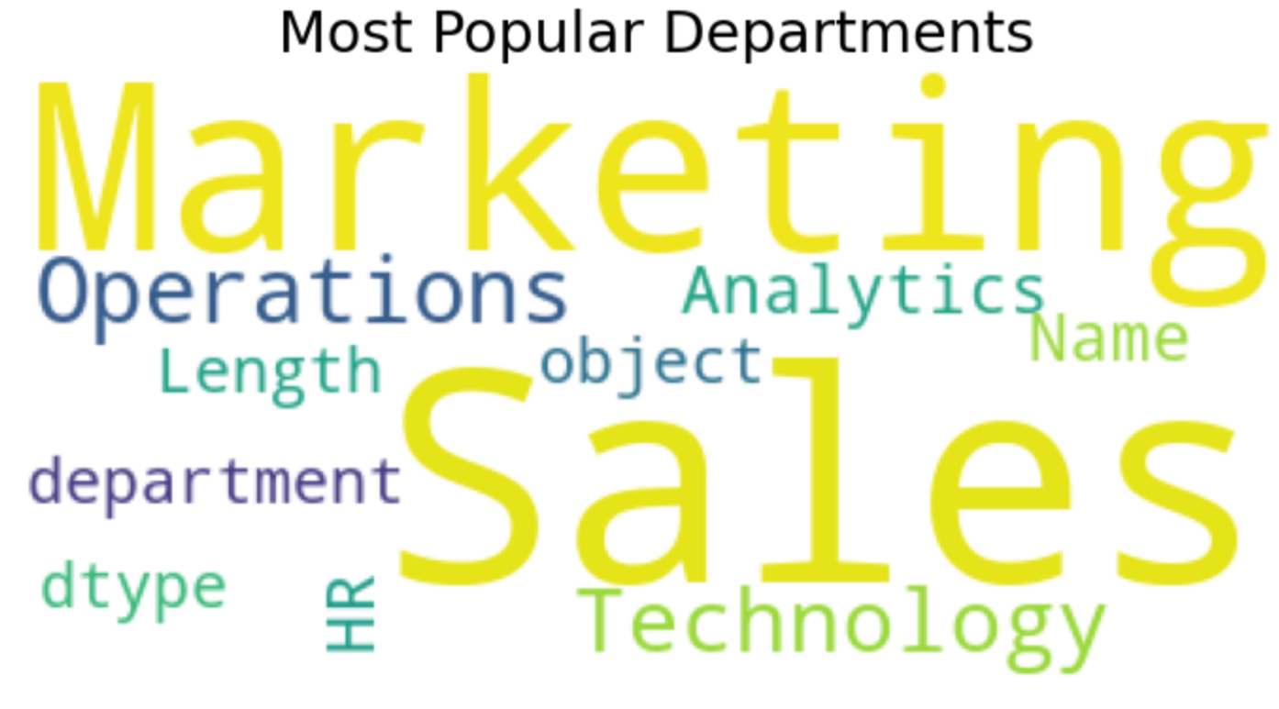
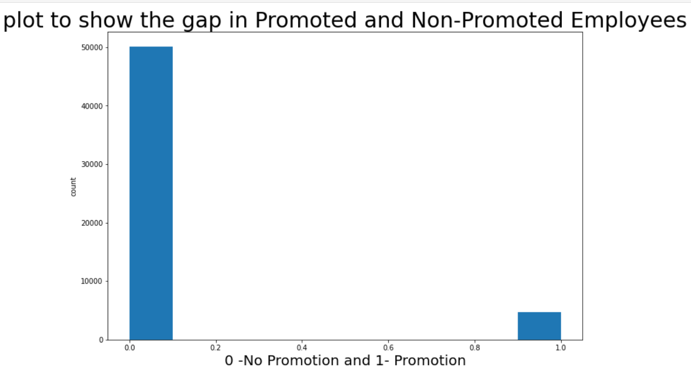
Tasks Under this project
UNi-variate Data Visualization
# checking the Most Popular Departments
# checkig the no. of Employees Promoted
# finding the %age of people promoted
#plotting a scatter plot

Slide 5
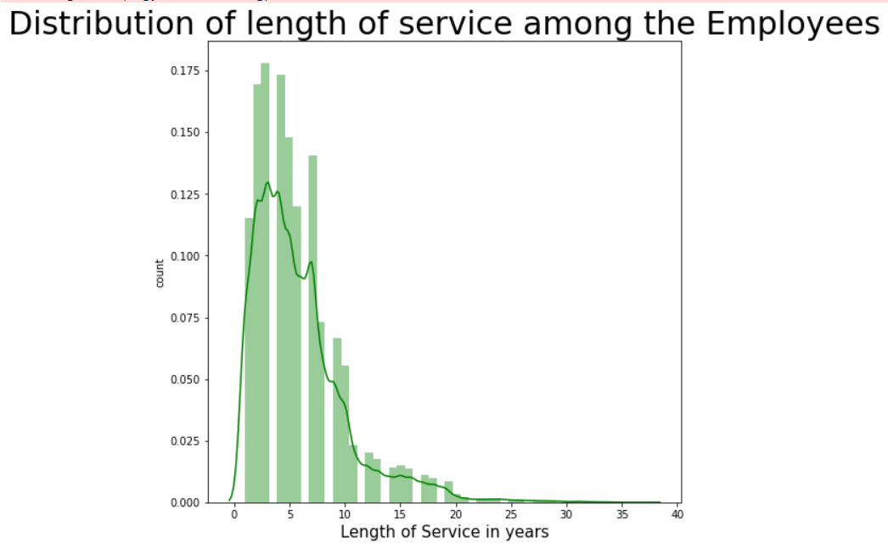
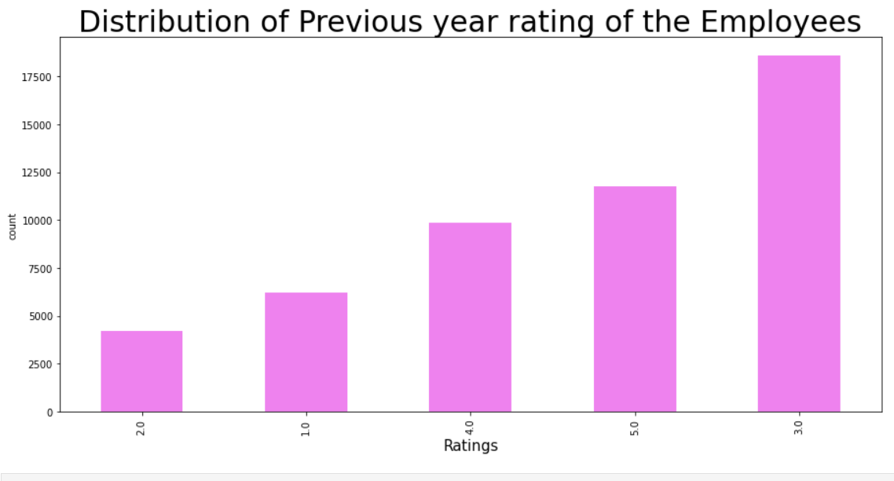
# checking the distribution of length of service
# 'Distribution of Previous year rating of the Employees’

Slide 6
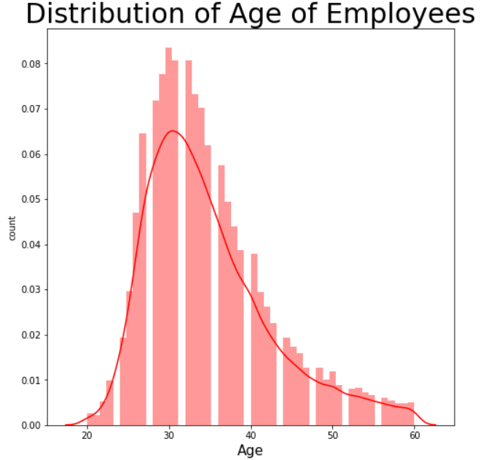
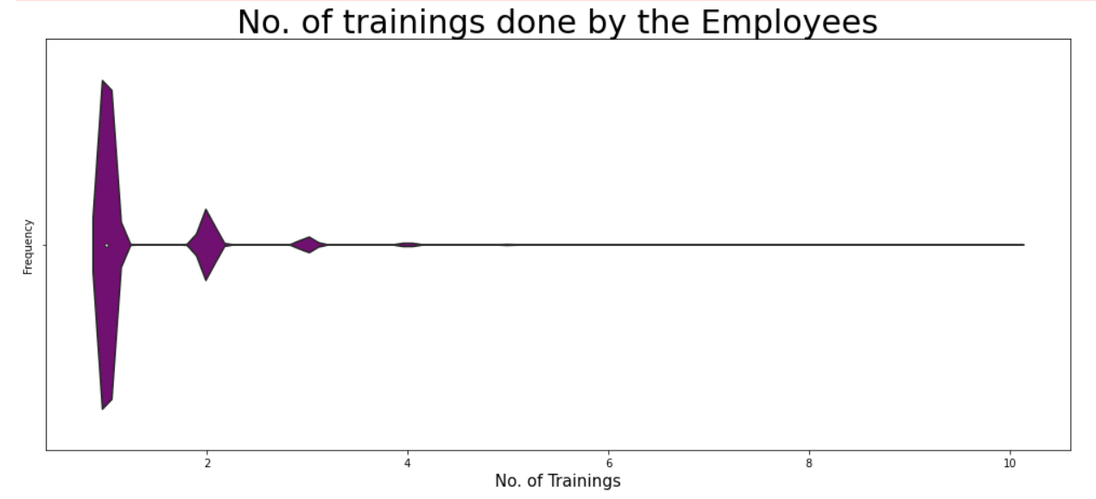
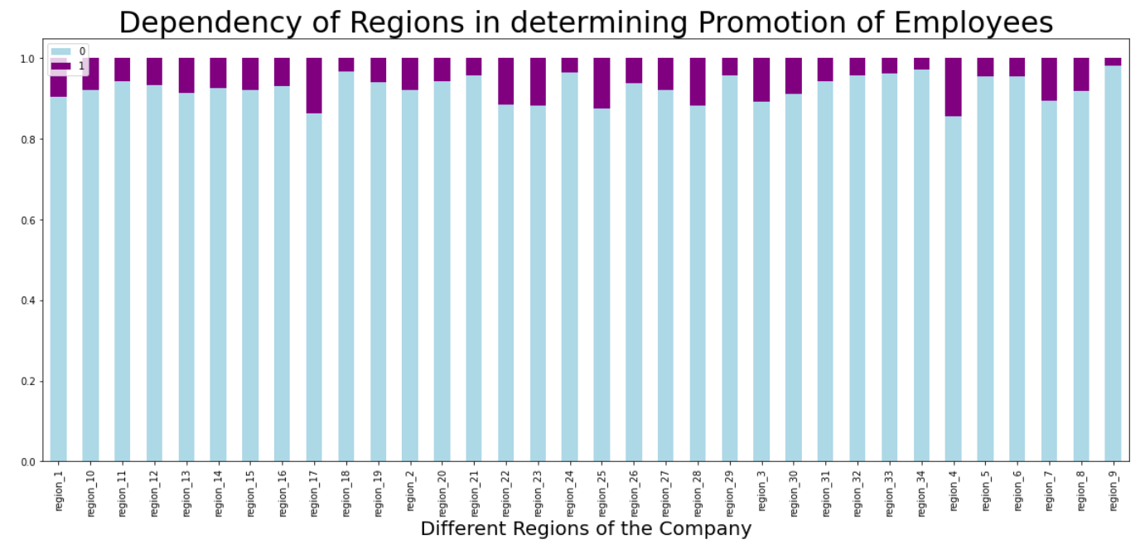
# checking the distribution of age of Employees in the company
# checking the different no. of training done by the employees
# checking dependency of different regions in promotion

